Slide 1
Video Streaming App Subscription Analysis
Understanding Customer Behavior and Revenue Trends
Name: Mohit Rathod
Date: 15th October 2025
GitHub Repo: View Here

Slide 2
INDEX
Introduction
Data Exploration and Transformation
Feature Engineering
Churn Analysis
Retention Analysis
Monthly New Subscribers
Customer Segmentation
Conclusion

Slide 3
INTRODUCTION
Goal: To analyze streaming video subscription data to understand customer behavior, identify key drivers of churn, and provide actionable insights for business growth.
Dataset: Subscription Cohort Analysis Data.csv, containing information on customer subscriptions, payment status, cancellation dates, etc.
Methodology: Data cleaning, exploratory data analysis, customer segmentation, and churn prediction using a machine learning model.

Slide 4
IMPORT LIBRARIES
Started by importing essential libraries for data manipulation, analysis, and visualization:
Pandas: For data handling and manipulation using DataFrames.
NumPy: For numerical computations and array operations.
Matplotlib: For creating static, interactive, and animated visualizations.

Slide 5
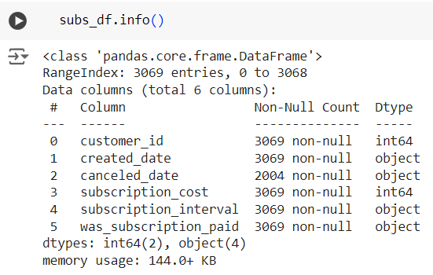
DATA EXPLORATION
Used subs_df.info() to:
Understand the structure of the dataset, including the number of rows and columns.
Check data types of each column (e.g., integer, float, object).
Identify missing values (null or NaN) in any columns.

Slide 6
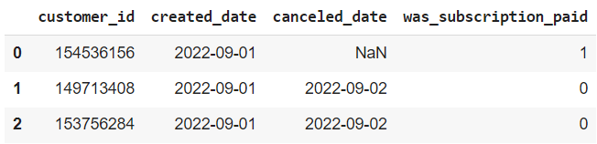
DATA TRANSFORMATION
Recoding Categorical Variables: Converted categorical variables like 'was_subscription_paid' (Yes/No) into numerical format (1/0) for memory efficiency and compatibility with machine learning models.
Date Handling: Transformed 'created_date' and 'canceled_date' columns into datetime objects for easier date-based calculations and analysis.

Slide 7
FEATURE ENGINEERING
Created new columns, such as 'created_month' and 'canceled_month,' by extracting the month from the respective date columns. This enabled monthly analysis of churn and other metrics.
Calculated the 'subscription_duration' by subtracting the creation date from the cancellation date, providing a measure of how long each subscription lasted.
Categorized subscription durations into groups ('0-7 days', '8-30 days', '31-60 days', '61-90 days', '91-120 days’, '121-150 days', '151-180 days', '181-365 days', '1-2 years’) using the pd.cut function to analyze retention patterns across different duration ranges.

Slide 8
CHURN ANALYSIS
Category | Total | Subscription Paid | Subscription Not Paid
Total Subscriptions | 3069 (100%) | 2936 (95.66%) | 133 (4.34%)
Cancellations | 2004 (65.29%) | 1881 (93.86%) | 123 (6.14%)
Higher Cancellation among Non-Paying Users indicates that free users are more likely to churn after their initial engagement.
Retention Strategy Opportunity:
Paid users show a stable retention pattern, but non-paying users present an opportunity for improvement. Focusing on converting free users into paying subscribers can reduce cancellations and enhance long-term growth.

Slide 9
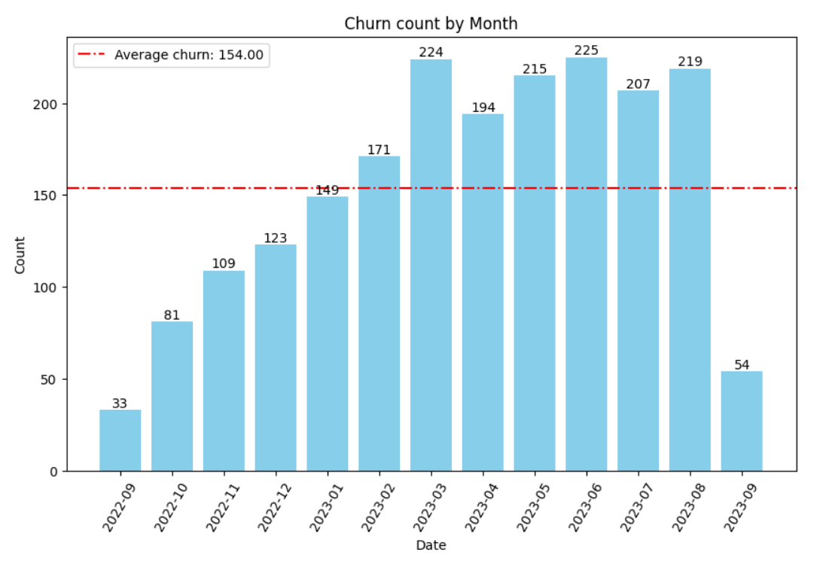
CHURN ANALYSIS
Total Customers Cancelled their Subscription by Month

Slide 10
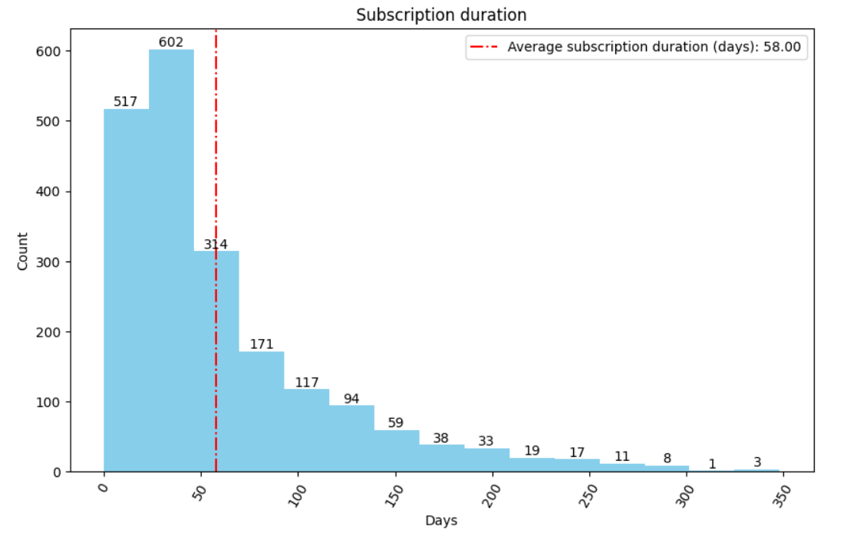
RETENTION ANALYSIS

Slide 11
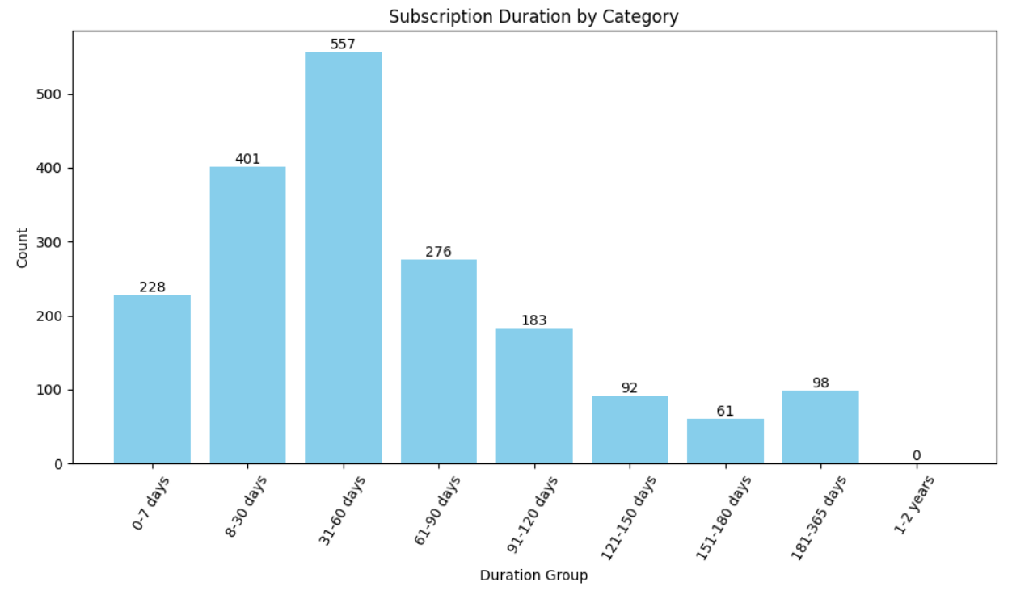
RETENTION ANALYSIS

Slide 12
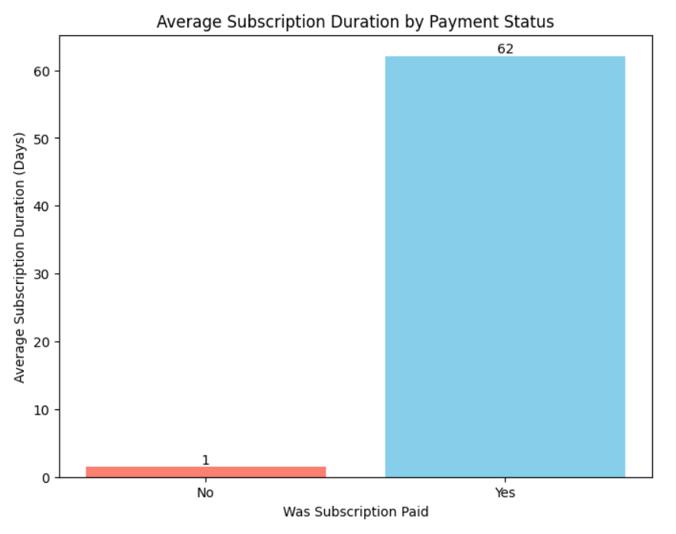
RETENTION ANALYSIS

Slide 13
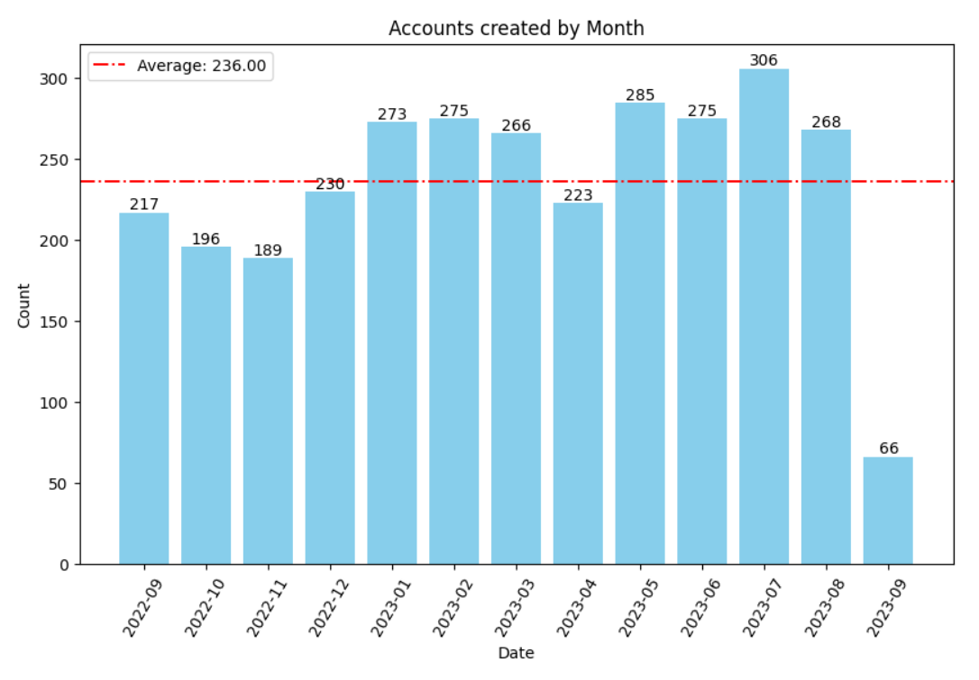
MONTHLY NEW SUBSCRIBERS

Slide 14
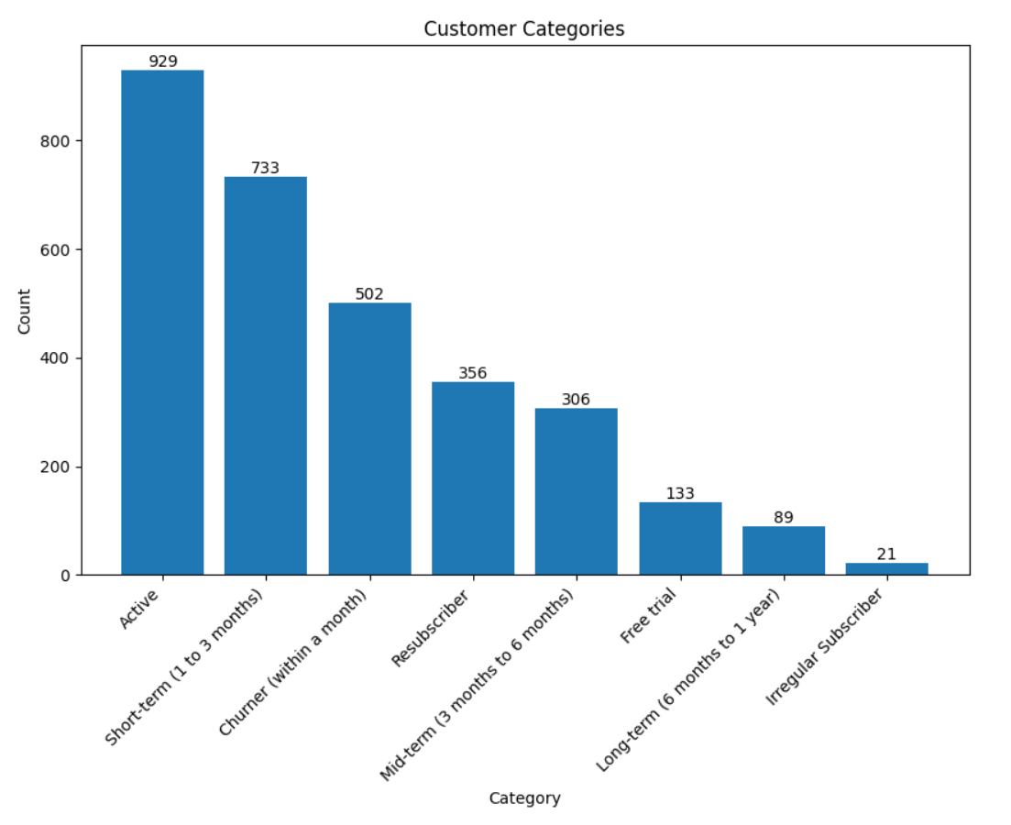
CUSTOMER SEGMENTATION

Slide 15
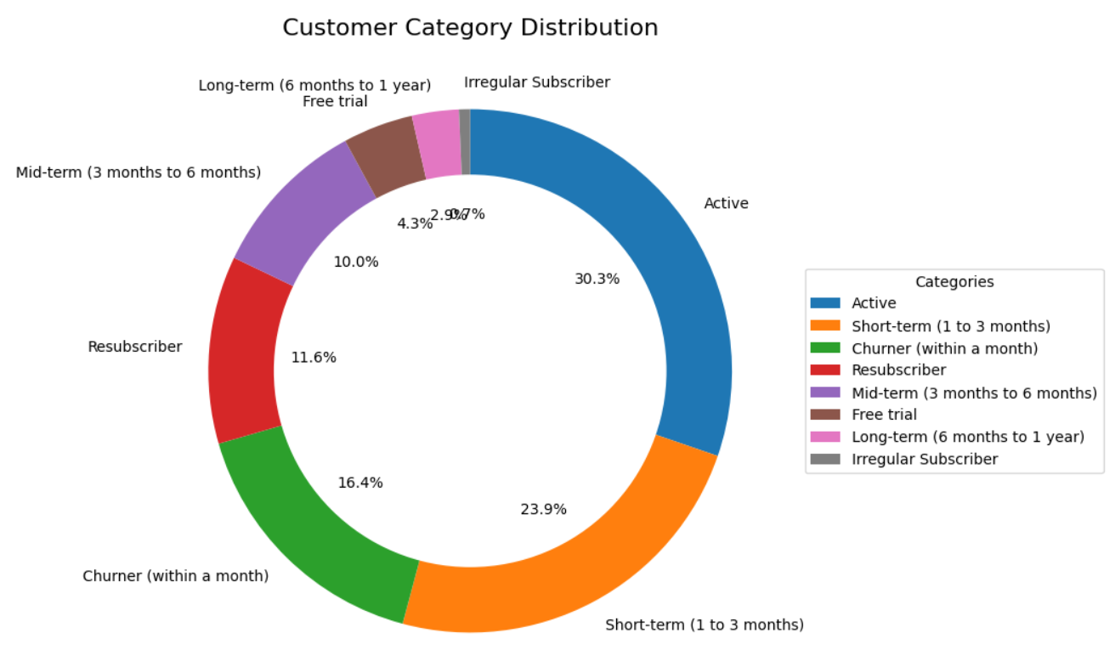
CUSTOMER SEGMENTATION

Slide 16
CONCLUSION
Key Insights: Identified key factors driving churn, including subscription duration, payment status, and customer categories.
Actionable Strategies: Developed data-driven recommendations for reducing churn, such as targeted interventions for high-risk segments and enhancing customer engagement.
Future Work: Outlined areas for future analysis, including investigating external factors and exploring more advanced predictive models.
Overall, this analysis provides a comprehensive understanding of subscription churn and empowers the business to make data-informed decisions for improved customer retention.

Slide 17
THANKYOU
Thank you for your time and attention throughout this presentation. I appreciate your interest and hope my work provided valuable insights.
Presented by: Mohit Rathod
Feel free to reach out for further inquiries or networking:
Email: mohitrathod.ca@gmail.com
LinkedIn: https://www.linkedin.com/in/mohit-rathod/
I look forward to connecting!

